Slide 1
Working With 4-Momenta

Slide 2
Sample Problems…
Problem: Imagine that somewhere in deep space a rock with mass 12kg is moving in the +x direction with v = 4/5 in some inertial frame. This rock then strikes another rock of mass m = 28kg at rest (v = 0). Pretend that the first rock simply bounces off the more massive rock and is subsequently observed to have an x-velocity of v = -5/13. What is the x-velocity v of the larger rock after the collision?

Slide 3
Determine p₁ and p₂ initial
Use conservation of 4-momentum
Try this using the 4-momentum Applet
Try this algebraically

Slide 4
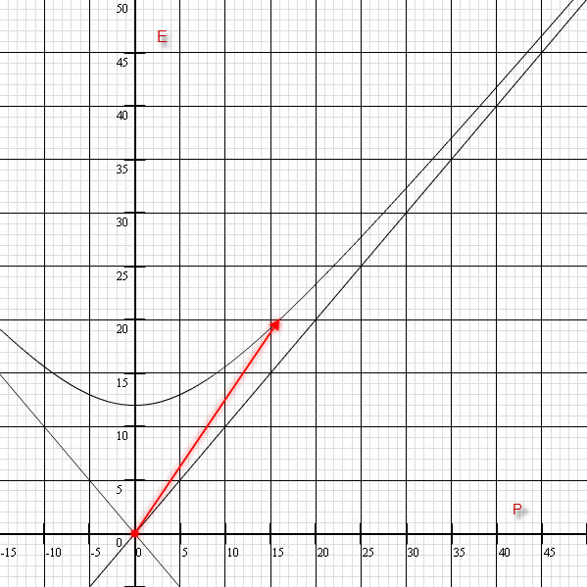

Slide 5
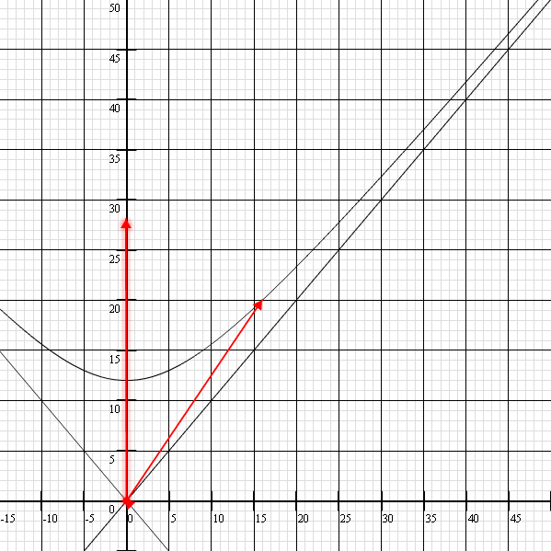

Slide 6
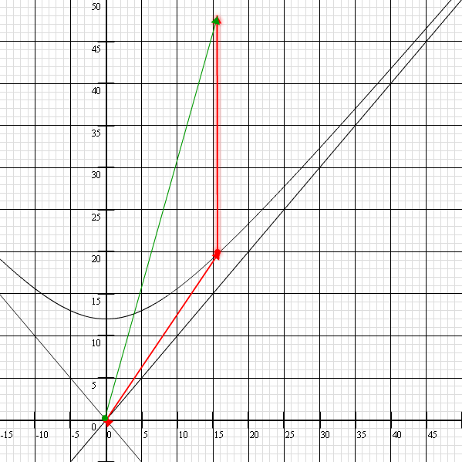

Slide 7
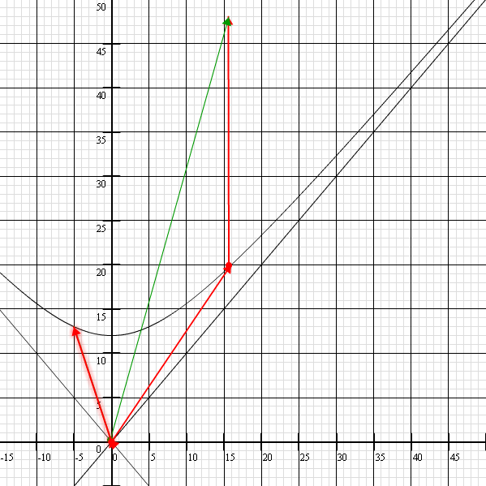

Slide 8
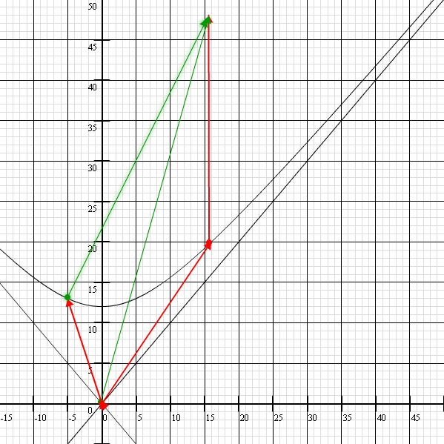

Slide 9
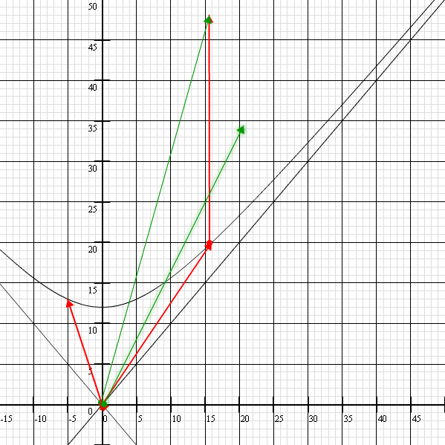
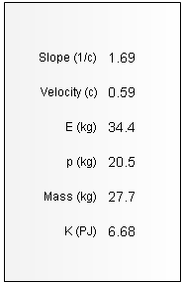

Slide 10
Problem #2 A π⁰ meson is moving with in the x-direction in a lab frame with a kinetic energy equal to twice its rest mass. The meson decays into two photons which travel opposite each other as seen from a rocket frame traveling with the meson. Find the energies of the two photons in both the rocket frame and the lab frame as well as their direction in the lab frame.

Slide 11
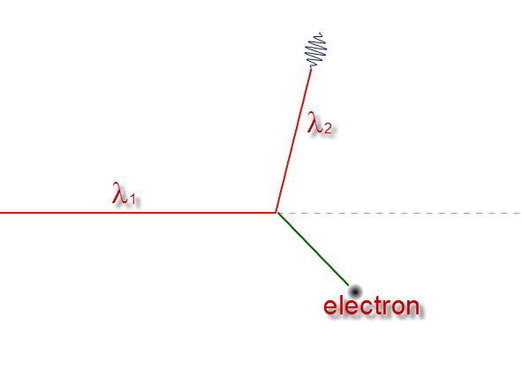
Problem #3 Show that a high energy photon will scatter when colliding with a stationary electron according to the Compton Formula:

